Slide 1

Title: Developing a Machine Learning Framework for Early Prediction of Heart Disease: A Comparative Study of Models and Feature Importance
University of Hertfordshire
Name: Somesh nakka
ID: 23006089

Slide 2
Introduction
•Healthcare data analysis improves decision-making and patient outcomes.
•Machine learning provides predictive prediction of patient outcomes.
•This project develops and tests predictive models for healthcare analytics.

Slide 3
Research Question & Objectives How effectively can machine learning algorithms predict heart disease based on patient demographic and clinical data, and which features and models contribute most significantly to accurate predictions?
Data Preprocessing and Feature Engineering: EDA is performed on the data for data quality verification, treatment of missing values, normalizing numeric features, and encoding of categorical variables.
2. Dataset Suitability: Ensure the dataset that will be used is balanced and representative. In cases of imbalanced datasets, any class imbalance has to be preprocessed accordingly through techniques like SMOTE or undersampling.
3 .Hyperparameter Tuning: The aim is to avoid overfitting and enhance the performance by tuning the models using Grid Search or Randomized Search.
4. Model Performance Evaluation: The performance of the models is going to be tested for accuracy, precision, recall, F1-score, AUC-ROC, and further analyzed using the confusion matrix.
5. Feature Importance Analysis: SHAP, permutation importance, and model-based techniques shall be employed to understand significant features of heart disease prediction.

Slide 4
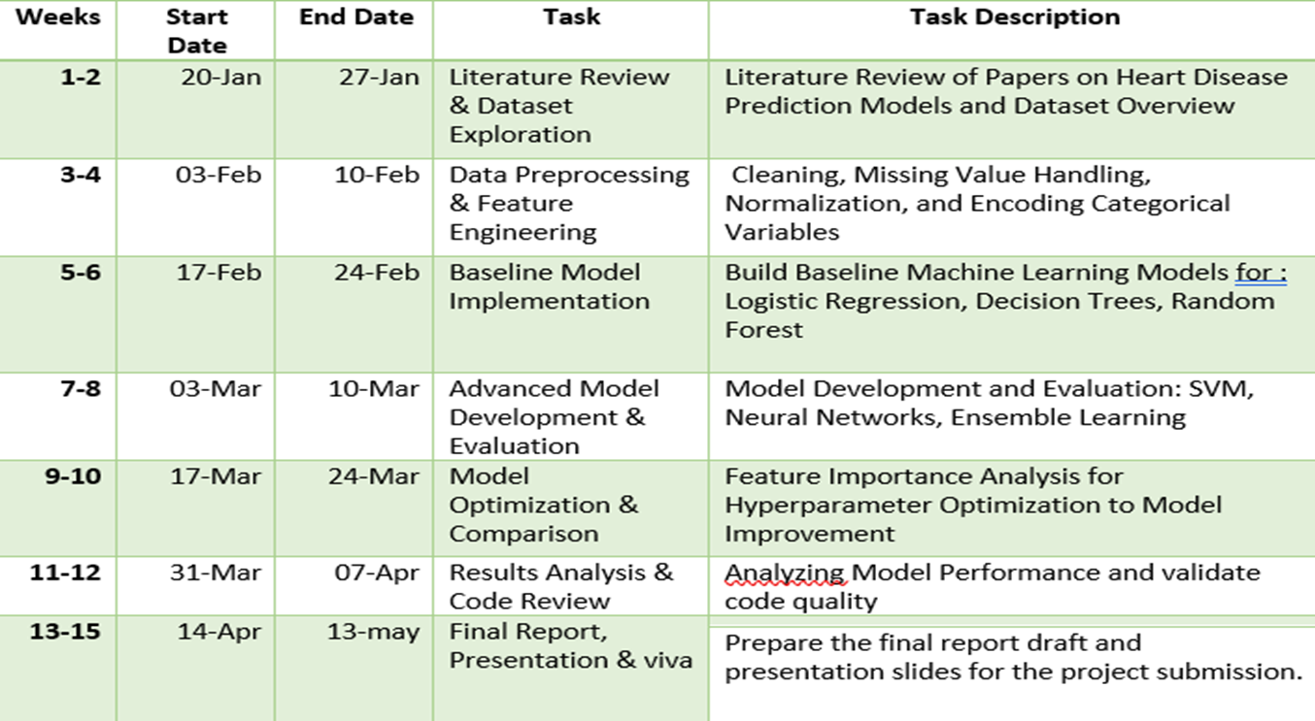
Project Plan – Task List

Slide 5
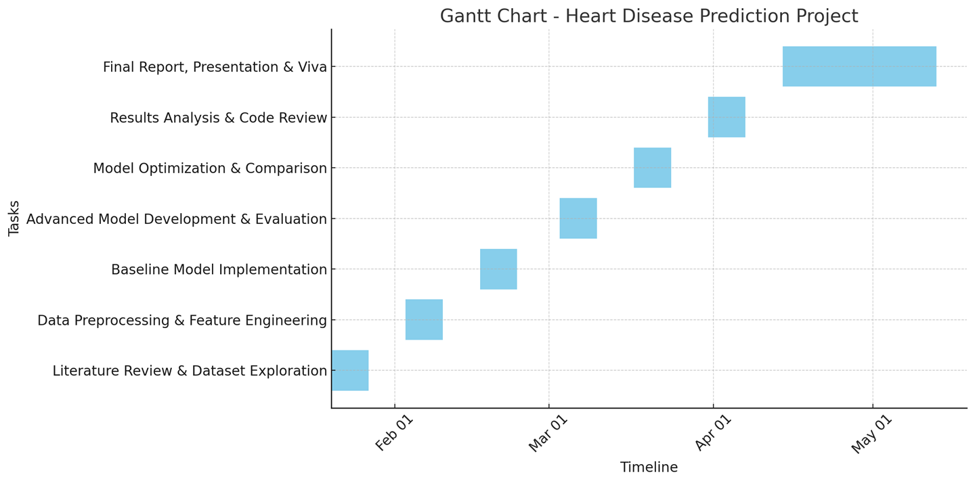
Project Timeline

Slide 6
Data Management Plan - Dataset Overview
• Source: Kaggle Healthcare Dataset.
• Contents: Patient demographics, test results, hospital admission data.
• Use Case: Predicting patient outcomes.
• Dataset link: https://www.kaggle.com/datasets/shantanugarg274/heart-prediction-dataset

Slide 7
Data Collection & Metadata
· Dataset Source: Kaggle (Heart Disease UCI Dataset)
· Format: CSV file ( 1000 samples)
· Features: Age, gender, cholesterol, resting blood pressure, ECG results, etc.
· Handling Missing Data: Imputation techniques.
· Ethical Considerations: GDPR compliance.

Slide 8

Version Control & Security
GitHub Link:
GitHub Repository: Weekly commits and updates.
Backup System: Secure storage on OneDrive.
Data Privacy Measures: Compliance with data regulations.
https://github.com/Somesh098/project-prediction-of-heart-disease.git

Slide 9
Project Impact
• Early detection and predictive analysis lead to better healthcare results.
• Potential integration with hospital decision-making systems.
• Future work includes expanding datasets and refining models.
• Improve generalization by testing models on real-world hospital data.

Slide 10
Conclusion
• This experiment shows how machine learning can predict patient outcomes using healthcare data.
• By comparing models, we discovered the most successful forecasting method and important influential features.
• Our findings emphasize the necessity of ethical data management, GDPR compliance, and reproducibility.

Slide 11
References
M. R. Ahmed, S. M. Hasan Mahmud, M. A. Hossin, H. Jahan and S. R. Haider Noori, "A Cloud Based Four-Tier Architecture for Early Detection of Heart Disease with Machine Learning Algorithms," 2018 IEEE 4th International Conference on Computer and Communications (ICCC), Chengdu, China, 2018, pp. 1951-1955, doi: 10.1109/CompComm.2018.8781022. URL: https://ieeexplore.ieee.org/stamp/stamp.jsp?tp=&arnumber=8781022&isnumber=8780575
2. V. M B, S. S. R, K. U and K. Y, "Exploratory Data Analysis of Heart Disease Prediction using Machine Learning Techniques-RS Algorithm," 2024 Second International Conference on Intelligent Cyber Physical Systems and Internet of Things (ICoICI), Coimbatore, India, 2024, pp. 209-216, doi: 10.1109/ICoICI62503.2024.10696414. URL: https://ieeexplore.ieee.org/stamp/stamp.jsp?tp=&arnumber=10696414&isnumber=10695948
3. A. Lakshmi and R. Devi, "Heart Disease Prediction Using Enhanced Whale Optimization Algorithm Based Feature Selection With Machine Learning Techniques," 2023 12th International Conference on System Modeling & Advancement in Research Trends (SMART), Moradabad, India, 2023, pp. 644-648, doi: 10.1109/SMART59791.2023.10428617. URL: https://ieeexplore.ieee.org/stamp/stamp.jsp?tp=&arnumber=10428617&isnumber=10428128

Slide 12

Thank You

